Slide 1
Programming Fundamentals 1

Slide 2
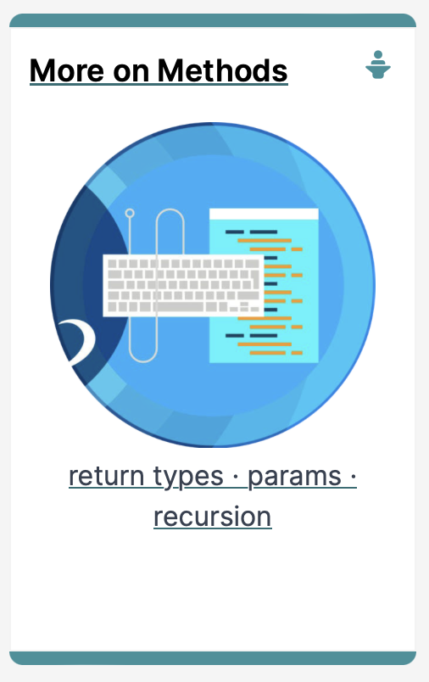
Introduction to Processing
More on writing your own Methods

Slide 3
Agenda
Method example: Eyes
Method example: X’s
Overloading methods.
Method example: Celcius / Farenheit Converter.
Recursion.

Slide 4

Method example: Eyes

Slide 5
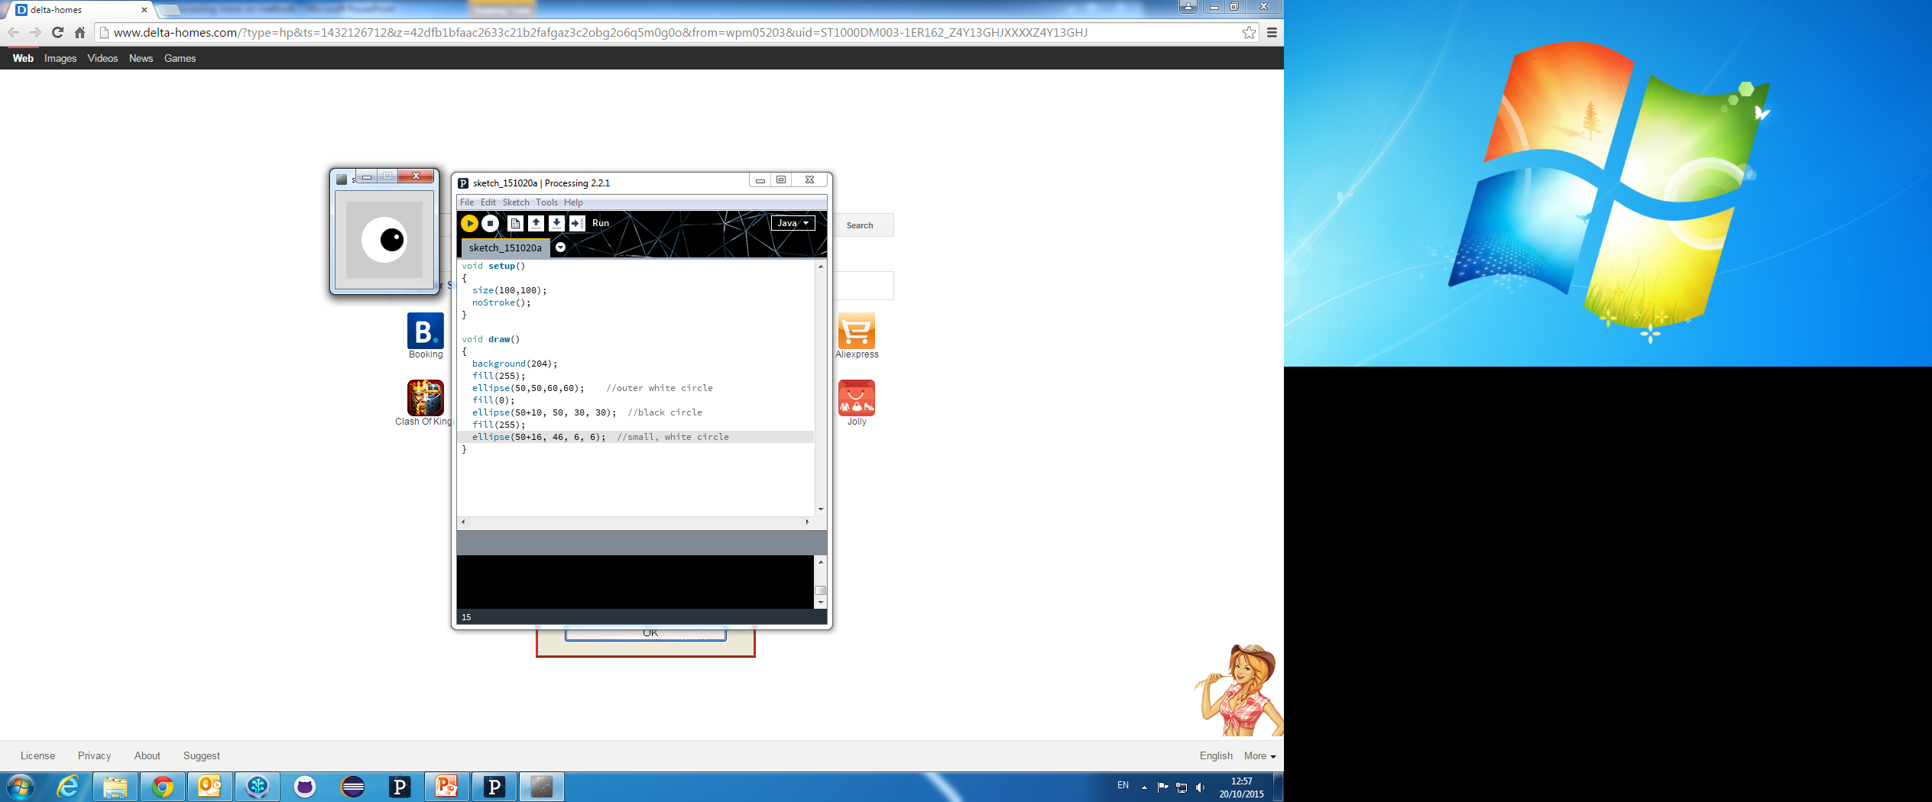
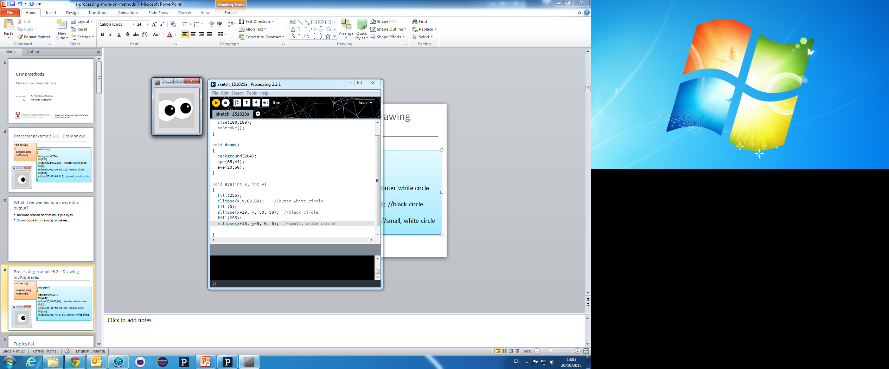
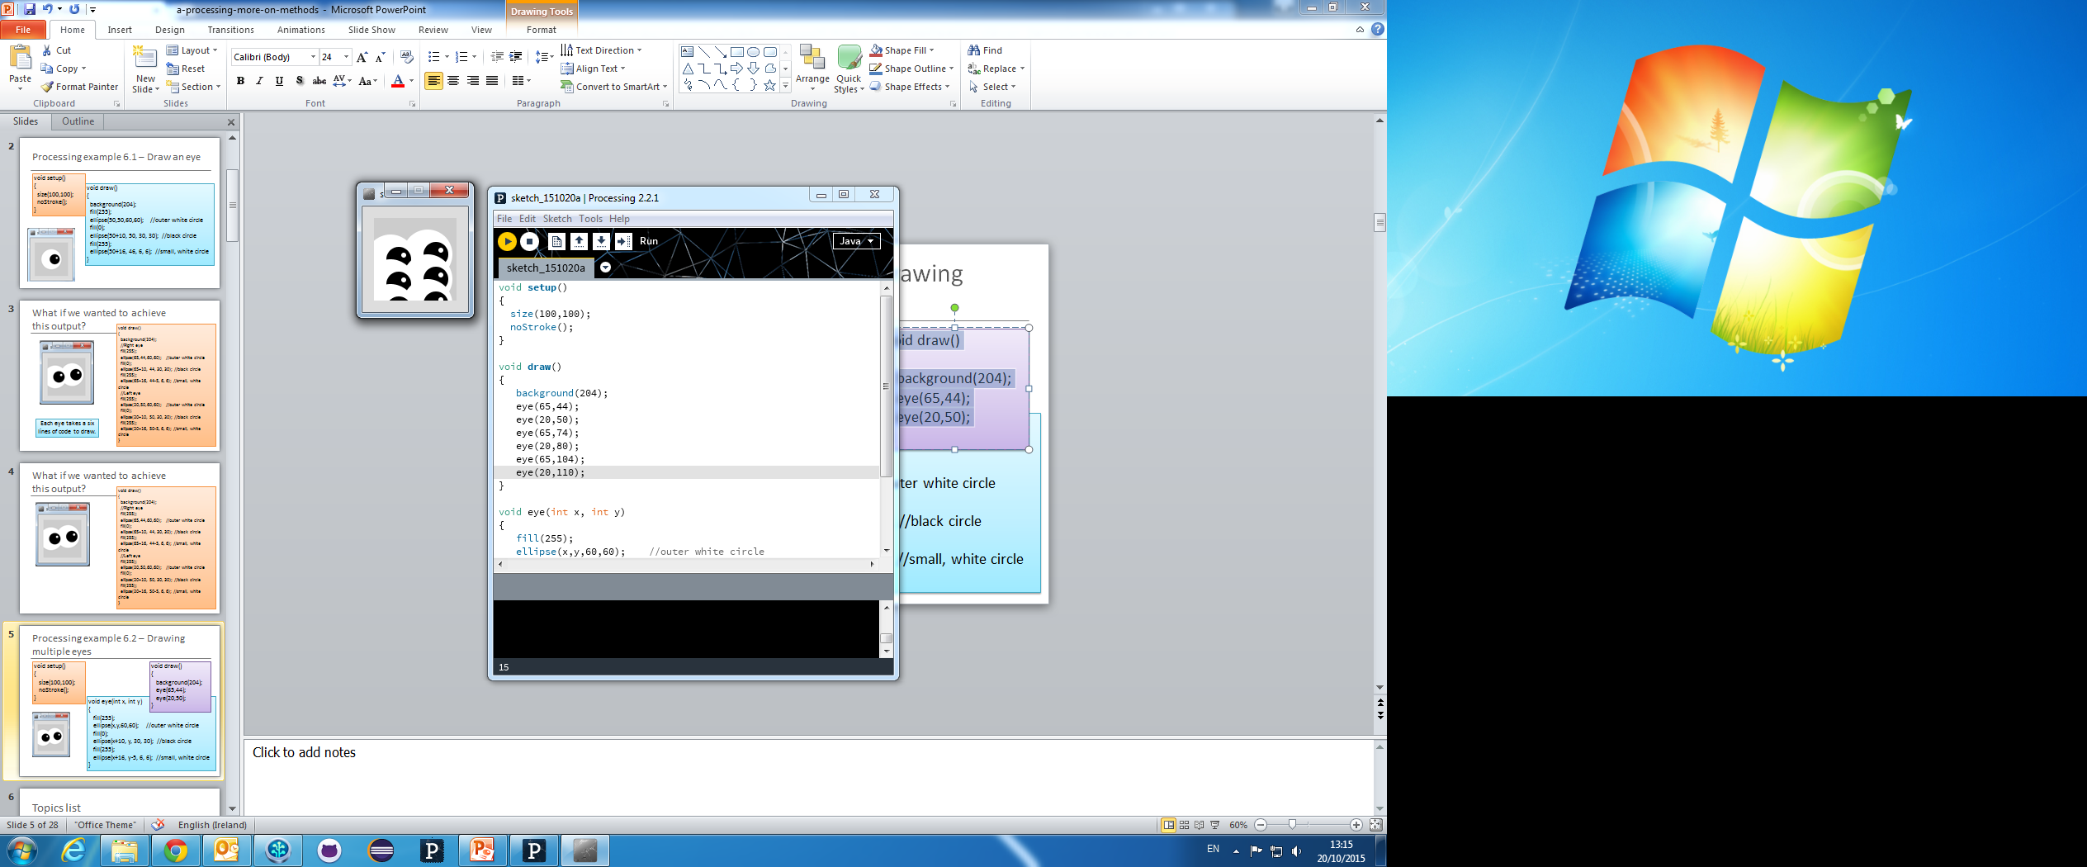

Slide 6
Example 6.1 – Drawing a single eye
void setup()
{
size(100,100);
noStroke();
}
void draw()
{
background(204);
fill(255);
ellipse(50,50,60,60); //outer white circle
fill(0);
ellipse(50+10, 50, 30, 30); //black circle
fill(255);
ellipse(50+16, 46, 6, 6); //small, white circle
}

Slide 7
What if we wanted to draw two eyes?
void draw()
{
background(204);
//Right eye
fill(255);
ellipse(65,44,60,60); //outer white circle
fill(0);
ellipse(65+10, 44, 30, 30); //black circle
fill(255);
ellipse(65+16, 44-5, 6, 6); //small, white circle
//Left eye
fill(255);
ellipse(20,50,60,60); //outer white circle
fill(0);
ellipse(20+10, 50, 30, 30); //black circle
fill(255);
ellipse(20+16, 50-5, 6, 6); //small, white circle
}
Each eye takes six lines of code to draw.

Slide 8
What if we wanted to draw six eyes?
Are we going to repeat the six lines of code SIX times?
What if we wanted to draw 100 eyes?
→ 600 lines of code!

Slide 9
Example 6.2 – Drawing two eyes
void setup()
{
size(100,100);
noStroke();
}
void draw()
{
background(204);
eye(65,44);
eye(20,50);
}
void eye (int x, int y)
{
fill(255);
ellipse(x,y,60,60); //outer white circle
fill(0);
ellipse(x+10, y, 30, 30); //black circle
fill(255);
ellipse(x+16, y-5, 6, 6); //small, white circle
}

Slide 10
Example 6.3 – Drawing six eyes
void setup()
{
size(100,100);
noStroke();
}
void draw()
{
background(204);
eye(65,44);
eye(20,50);
eye(65,74);
eye(20,80);
eye(65,104);
eye(20,110);
}
void eye (int x, int y)
{
fill(255);
ellipse(x,y,60,60); //outer white circle
fill(0);
ellipse(x+10, y, 30, 30); //black circle
fill(255);
ellipse(x+16, y-5, 6, 6); //small, white circle
}

Slide 11
Method example: X’s

Slide 12
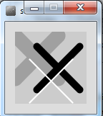

Slide 13
How about this solution?
void draw(){
background(204);
//draw thick, light gray x
stroke(160);
strokeWeight(20);
line(0,5,60,65);
line(60,5,0,65);
//draw medium, black x
stroke(0);
strokeWeight(10);
line(30,20,90,80);
line(90,20,30,80);
//draw thin, white x
stroke(255);
strokeWeight(2);
line(20,38,80,98);
line(80,38,20,98);
}
void setup() {
size(100,100);
}

Slide 14
Code duplication
//draw thick, light gray x
stroke(160);
strokeWeight(20);
line(0,5,60,65);
line(60,5,0,65);
//draw medium, black x
stroke(0);
strokeWeight(10);
line(30,20,90,80);
line(90,20,30,80);
//draw thin, white x
stroke(255);
strokeWeight(2);
line(20,38,80,98);
line(80,38,20,98);

Slide 15
A solution with methods
We will incrementally build a solution that uses methods to produce this output…

Slide 16
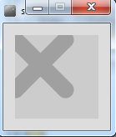
Example 6.4 – a method to draw a thick, light gray X
void draw()
{
background(204);
drawX();
}
void drawX()
{
stroke(160);
strokeWeight(20);
line(0,5,60,65);
line(60,5,0,65);
}

Slide 17
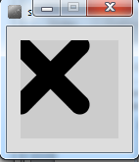
Example 6.5 – drawing a thick X, passing colour as a parameter
void draw()
{
background(204);
drawX(0);
}
void drawX (int gray)
{
stroke(gray);
strokeWeight(20);
line(0,5,60,65);
line(60,5,0,65);
}

Slide 18
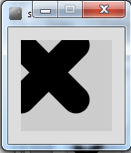
Example 6.6 – drawing X, passing colour and weight.
void draw()
{
background(204);
drawX(0, 30);
}
void drawX (int gray, int weight)
{
stroke(gray);
strokeWeight(weight);
line(0,5,60,65);
line(60,5,0,65);
}

Slide 19
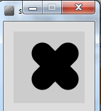
Example 6.7 – drawing X, passing colour, weight, position, size
void draw()
{
background(204);
drawX(0, 30, 40, 30, 36);
}
void drawX (int gray, int weight, int x, int y, int size)
{
stroke(gray);
strokeWeight(weight);
line(x, y, x+size, y+size);
line(x+size, y, x, y+size);
}

Slide 20
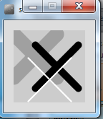
Example 6.8 – drawing multiple Xs
void draw()
{
background(204);
drawX(160, 20, 0, 5, 60);
drawX(0, 10, 30, 20, 60);
drawX(255, 2, 20, 38, 60);
}
void drawX (int gray, int weight, int x, int y, int size)
{
stroke(gray);
strokeWeight(weight);
line(x, y, x+size, y+size);
line(x+size, y, x, y+size);
}

Slide 21
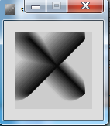
Example 6.9 – drawing multiple Xs using a for loop
void draw()
{
background(204);
for (int i = 0; i < 20; i++){
drawX(200-i*10, (20-i)*2, i, i/2, 70);
}
}
void drawX(int gray, int weight, int x, int y, int size)
{
stroke(gray);
strokeWeight(weight);
line(x, y, x+size, y+size);
line(x+size, y, x, y+size);
}

Slide 22
Overloading Methods

Slide 23
Overloaded methods
Multiple methods can have the same name, once they have a different parameter list.
In the previous examples, we wrote the following methods:
void drawX ()
void drawX (int gray)
void drawX (int gray, int weight)
void drawX (int gray, int weight, int x, int y, int size)
Source: Reas & Fry (2014)

Slide 24
Overloaded methods
Multiple methods can have the same name, once they have a different parameter list.
In the previous examples, we wrote the following methods:
void drawX ()
void drawX (int gray)
void drawX (int gray, int weight)
void drawX (int gray, int weight, int x, int y, int size)
Same Name
Different Parameter List

Slide 25
Overloaded methods
Method signature | Parameter List
void drawX () | no parameter
void drawX (int gray) | int
void drawX (int gray, int weight) | int, int
void drawX (int gray, int weight, int x, int y, int size) | int, int, int, int, int

Slide 26
Overloaded methods
A program can have two or more methods with the same name, only if their parameter list is different.
When Java is checking that a parameter list is different, it is not checking the name of the variables, it is checking the data type of the variables e.g. this is permitted as the data type is different:
void drawX ( int gray)
void drawX ( float gray)
Data types must be different

Slide 27
Overloaded methods
void drawX(int gray){
stroke(gray);
strokeWeight(5);
line(0,5,60,65);
line(60,5,0,65);
}
void drawX(float gray){
stroke(gray);
strokeWeight(20);
line(0,5,60,65);
line(60,5,0,65);
}
void draw()
{
background(204);
drawX(0);
}
Which drawX method is called and why?

Slide 28
Overloaded methods
When you call a method, Java matches the number and type of the arguments you passed to the method with all the declared methods.
When a match is found, Java invokes that method e.g.
drawX(0) calls void drawX (int gray)
drawX(0.0) calls void drawX (float gray)

Slide 29
Method example: Celcius / Farenheit Converter

Slide 30
Example 6.10 – Farenheit to Celsius
Farenheit value is hardcoded as a literal
void setup()
{
float celsius = farenheitToCelsius (451.0);
println("Celsius value is: " + celsius);
}
float farenheitToCelsius (float farenheit)
{
float result = (farenheit - 32.0) * (5.0/9.0);
return result;
}
Return type

Slide 31
Example 6.10 – Farenheit to Celsius
Farenheit value is hardcoded as a literal
void setup()
{
float celsius = farenheitToCelsius (451.0);
println("Celsius value is: " + celsius);
}
Celsius value is: 232.77779
float farenheitToCelsius (float farenheit)
{
float result = (farenheit - 32.0) * (5.0/9.0);
return result;
}

Slide 32
Example 6.10 – Updated
float farenheitToCelsius (float farenheit)
{
float result = (farenheit - 32.0) * (5.0/9.0);
return result;
}
both methods are exactly the same
float farenheitToCelsius (float farenheit)
{
return (farenheit - 32.0) * (5.0/9.0);
}

Slide 33
Recursion

Slide 34
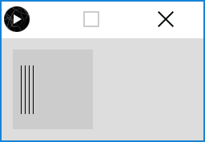
Example 6.11 – drawLines – for loop
void setup()
{
size(100,100);
drawLines(10,4);
}
void drawLines (int xStart, int numLines)
{
for (int i = 0; i < numLines; numLines--)
{
line (xStart, 20, xStart, 80);
xStart += 5;
}
}
Notes:
This is a tricky one

Slide 35
Example 6.11 – drawLines – for loop
void setup()
{
size(100,100);
drawLines(10,4);
}
void drawLines (int xStart, int numLines)
{
for (int i = 0; i < numLines; numLines--)
{
line (xStart, 20, xStart, 80);
xStart += 5;
}
}
*NOTE* instead of incrementing the loop control variable i as normal (e.g. i++)
the condition is being reduced back to 0 (by decrementing numLines)
Notes:
This is a tricky one

Slide 36
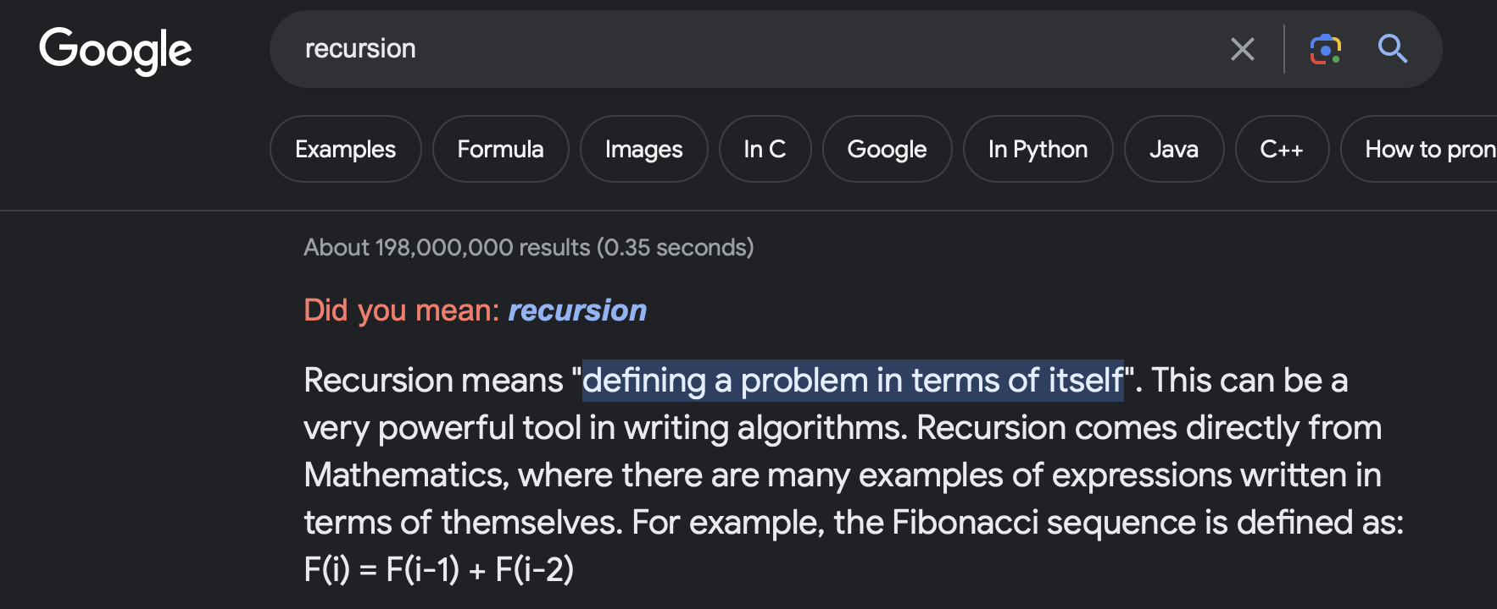
Recursion
A method can contain a line of code that calls itself
This is called recursion.

Slide 37
Recursion continued…
To stop the infinite calling of the method, it is necessary to have some way for the method to exit.
This is called the base case.
You continually work towards the base case.

Slide 38
Example 6.11 – drawLines – recursion
void setup()
{
size(100,100);
drawLines(10,4);
}
void drawLines (int x, int num)
{
line (x, 20, x, 80);
if (num > 1)
{
drawLines (x+5, num-1);
}
}
Notes:
void setup(){ size(100,100); drawLines(10,4);}
void drawLines (int x, int num){ // println( num); line (x, 20, x, 80); if (num > 1) { drawLines(x+5, num-1); }

Slide 39
Example 6.11
Having reached the base case, return back up the call stack to the original call
void drawLines (int x, int num){
line (x, 20, x, 80);
if (num > 1)
{
drawLines (x+5, num-1);
}
}
drawLines (10, 4);
line (10, 20, 10, 80);
x=10, num=4 (is > 1)
drawLines (15, 3);
line (15, 20, 15, 80); x=15, num=3 (is > 1)
drawLines (20, 2); line (20, 20, 20, 80);
x=20, num=2 (is > 1)
Successive Method Calls
Base case met
drawLines (25, 1); line (25, 20, 25, 80);
x=25, num=1 (is NOT > 1)

Slide 40
Summary
Method example: Eyes
Method example: X’s
Overloading methods
Method example: Celcius / Farenheit Converter
Recursion

Slide 41

Questions?

Slide 42
References
Reas, C. & Fry, B. (2014) Processing – A Programming Handbook for Visual Designers and Artists, 2nd Edition, MIT Press, London.

Slide 43



